Slide 1
HADOOP Dr. Daphne Lopez and Dr. Brijendra Singh VIT Vellore

Slide 2
What is Hadoop?
Open source software framework designed for storage and processing of large scale data on clusters of commodity hardware.
Created by Doug Cutting and Mike Carafella in 2005.
Cutting named the program after his son’s toy elephant.

Slide 3
Use cases for Apache Hadoop
Analytics and big data
A wide variety of companies and organizations use Hadoop for research, production data processing, and analytics that require processing terabytes or petabytes of big data, storing diverse datasets, and data parallel processing.

Slide 4
Use cases for Apache Hadoop
Data storage and archiving
As Hadoop enables mass storage on commodity hardware, it is useful as a low-cost storage option for all kinds of data, such as transactions, click streams, or sensor and machine data.
Risk management
Banks, insurance companies, and other financial services companies use Hadoop to build risk analysis and management models.

Slide 5
Use cases for Apache Hadoop
Data lakes
Since Hadoop can help store data without preprocessing, it can be used to complement to data lakes, where large amounts of unrefined data are stored.
Marketing analytics
Marketing departments often use Hadoop to store and analyze customer relationship management (CRM) data.

Slide 6
Use cases for Apache Hadoop
AI and Machine Learning
Hadoop ecosystems help with the processing of data and model training operations for machine learning applications.

Slide 7
Hadoop Ecosystem and its components
Hadoop has a large ecosystem of open source tools that can augment and extend the capabilities of the core module. Some of the main software tools used with Hadoop include:
Apache Hive: A data warehouse that allows programmers to work with data in HDFS using a query language called HiveQL, which is similar to SQL
Apache HBase: An open source non-relational distributed database often paired with Hadoop
Apache Pig: A tool used as an abstraction layer over MapReduce to analyze large sets of data and enables functions like filter, sort, load, and join

Slide 8
Hadoop Ecosystem and its components
Apache Impala: Open source, massively parallel processing SQL query engine often used with Hadoop
Apache Sqoop: A command-line interface application for efficiently transferring bulk data between relational databases and Hadoop
Apache ZooKeeper: An open source server that enables reliable distributed coordination in Hadoop; a service for, "maintaining configuration information, naming, providing distributed synchronization, and providing group services"
Apache Oozie: A workflow scheduler for Hadoop jobs

Slide 9
Features
• Suitable for Big Data Analysis
• Scalability
• Fault Tolerance

Slide 10
Suitable for Big Data Analysis
As an open source framework that can run on commodity hardware and has a large ecosystem of tools, Hadoop is a low-cost option for the storage and management of big data.

Slide 11
Scalability
Hadoop is important as one of the primary tools to store and process huge amounts of data quickly. It does this by using a distributed computing model which enables the fast processing of data that can be rapidly scaled by adding computing nodes.

Slide 12
Fault Tolerance
As a distributed computing model, Hadoop allows for fault tolerance and system resilience, meaning if one of the hardware nodes fail, jobs are redirected to other nodes.
Data stored on one Hadoop cluster is replicated across other nodes within the system to fortify against the possibility of hardware or software failure.

Slide 13
Hadoop Architecture
Hadoop Architecture comprises three major layers. They are:-
HDFS (Hadoop Distributed File System)
Yarn
MapReduce

Slide 14
Hadoop Architecture
HDFS
HDFS stands for Hadoop Distributed File System. It provides for data storage of Hadoop. HDFS splits the data unit into smaller units called blocks and stores them in a distributed manner. It has got two daemons running. One for master node – NameNode and other for slave nodes – DataNode.
Notes:
Daemon is a program that runs continuously as a background process and wakes up to handle periodic service request.

Slide 15
Hadoop Architecture
HDFS works best with a smaller number of large files
Files in HDFS are write once
Optimized for streaming reads of large files and not random reads

Slide 16
Name Node and Data Node
HDFS has a Master-slave architecture. The daemon called NameNode runs on the master server. It is responsible for Namespace management and regulates file access by the client.
DataNode daemon runs on slave nodes. It is responsible for storing actual business data. Internally, a file gets split into a number of data blocks and stored on a group of slave machines.

Slide 17
Name Node and Data Node
Namenode manages modifications to file system namespace. These are actions like the opening, closing and renaming files or directories.
NameNode also keeps track of mapping of blocks to DataNodes.
This DataNodes serves read/write request from the file system’s client.
DataNode also creates, deletes and replicates blocks on demand from NameNode.

Slide 18
NameNode and Data Node
Stores the HDFS file system information in a fsimage
Updates to the file system (add/remove blocks) do not change the fsimage file
They are instead written to a log file
When NameNode starts up, it loads the fsimage file and then applies the changes in the log file.
Notes:
FsImage is a file stored on the OS filesystem that contains the complete directory structure (namespace) of the HDFS

Slide 19
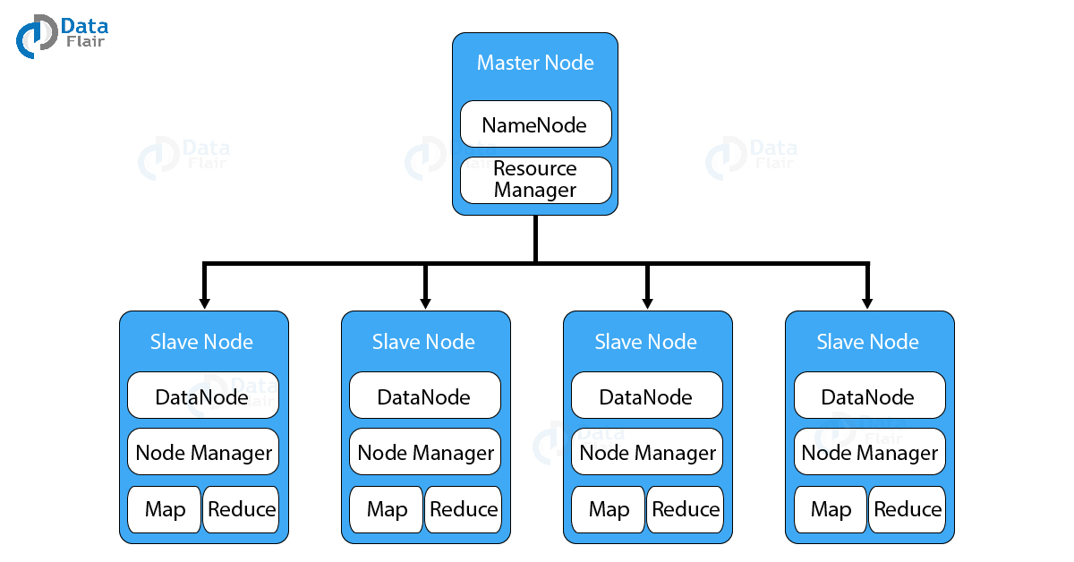

Slide 20
HDFS
Java is the native language of HDFS. Hence one can deploy DataNode and NameNode on machines having Java installed. In a typical deployment, there is one dedicated machine running NameNode. And all the other nodes in the cluster run DataNode. The NameNode contains metadata like the location of blocks on the DataNodes and arbitrates resources among various competing DataNodes.

Slide 21
Storage of files
Files are split into blocks
Blocks are split across many machines at load time
Different blocks from the same file will be stored on different machines
Blocks are replicated across multiple machines
Provides reliability through data replication
The NameNode keeps track of which blocks make up a file and where they are stored

Slide 22
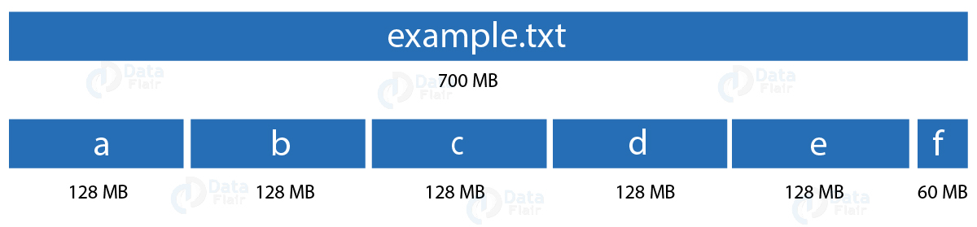
Blocks
Block is the smallest unit of storage on a computer system. It is the smallest contiguous storage allocated to a file. In Hadoop, we have a default block size of 128MB or 256 MB

Slide 23
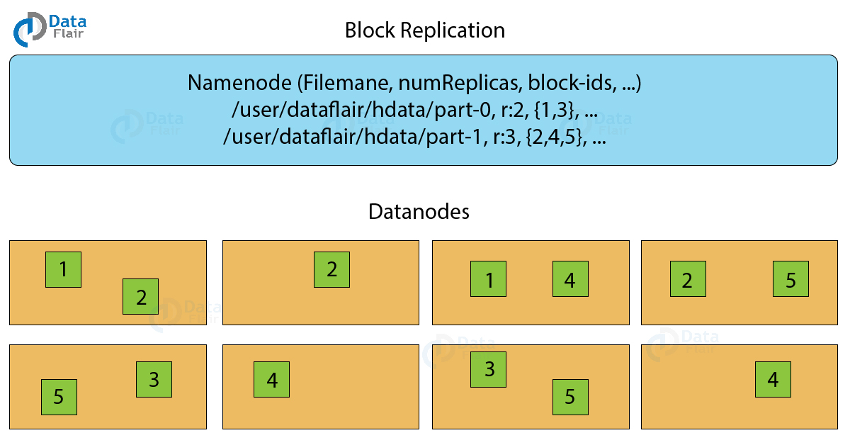
Replication Management
To provide fault tolerance HDFS uses a replication technique. In that, it makes copies of the blocks and stores in on different DataNodes. Replication factor decides how many copies of the blocks get stored. It is 3 by default but we can configure to any value.

Slide 24
YARN
YARN or Yet Another Resource Negotiator is the resource management layer of Hadoop. The basic principle behind YARN is to separate resource management and job scheduling/monitoring function into separate daemons. In YARN there is one global ResourceManager and per-application ApplicationMaster. An Application can be a single job or a DAG of jobs.
Inside the YARN framework, we have two daemons ResourceManager and NodeManager. The ResourceManager arbitrates resources among all the competing applications in the system. The job of NodeManger is to monitor the resource usage by the container and report the same to ResourceManger. The resources are like CPU, memory, disk, network and so on.

Slide 25

Hadoop Architecture

Slide 26
Hadoop Cluster Anatomy
NameNode
Holds the metadata for the HDFS
Secondary NameNode
Performs housekeeping functions for the NameNode
DataNode
Stores the actual HDFS data blocks
JobTracker
Manages MapReduce jobs
TaskTracker
Monitors individual Map and Reduce tasks

Slide 27
Secondary NameNode
NOT a backup for the NameNode
Periodically reads the log file and applies the changes to the fsimage file bringing it up to date
Allows the NameNode to restart faster when required
Notes:
Secondary name node is also called check point node

Slide 28
JobTracker and TaskTracker
JobTracker
Determines the execution plan for the job
Assigns individual tasks
TaskTracker
Keeps track of the performance of an individual mapper or reducer

Slide 29
Communication protocols
HDFS communication protocols are layered on top of the TCP/IP protocol. A client establishes a connection to a configurable TCP port on the NameNode machine. It talks the ClientProtocol with the NameNode. The DataNodes talk to the NameNode using the DataNode Protocol.
A Remote Procedure Call (RPC) abstraction wraps both the Client Protocol and the DataNode Protocol.

Slide 30
Robustness
The primary objective of HDFS is to store data reliably even in the presence of failures. The three common types of failures are NameNode failures, DataNode failures and network partitions.

Slide 31
Data Disk Failure, Heartbeats and Re-Replication
Each DataNode sends a Heartbeat message to the NameNode periodically.
A network partition can cause a subset of DataNodes to lose connectivity with the NameNode. The NameNode detects this condition by the absence of a Heartbeat message.
The NameNode marks DataNodes without recent Heartbeats as dead and does not forward any new IO requests to them. Any data that was registered to a dead DataNode is not available to HDFS any more.

Slide 32
Data Disk Failure, Heartbeats and Re-Replication
DataNode death may cause the replication factor of some blocks to fall below their specified value. The NameNode constantly tracks which blocks need to be replicated and initiates replication whenever necessary.
The necessity for re-replication may arise due to many reasons: a DataNode may become unavailable, a replica may become corrupted, a hard disk on a DataNode may fail, or the replication factor of a file may be increased.

Slide 33
Cluster Rebalancing
The HDFS architecture is compatible with data rebalancing schemes. A scheme might automatically move data from one DataNode to another if the free space on a DataNode falls below a certain threshold.

Slide 34
Data Integrity
It is possible that a block of data fetched from a DataNode arrives corrupted. This corruption can occur because of faults in a storage device, network faults, or buggy software and is rectified using checksum. The HDFS client software implements checksum checking on the contents of HDFS files.
When a client creates an HDFS file, it computes a checksum of each block of the file and stores these checksums in a separate hidden file in the same HDFS namespace. When a client retrieves file contents it verifies that the data it received from each DataNode matches the checksum stored in the associated checksum file. If not, then the client can opt to retrieve that block from another DataNode that has a replica of that block.

Slide 35
Metadata Disk Failure
The FsImage and the EditLog are central data structures of HDFS. A corruption of these files can cause the HDFS instance to be non-functional. For this reason, the NameNode can be configured to support maintaining multiple copies of the FsImage and EditLog.

Slide 36
Snapshots
Snapshots support storing a copy of data at a particular instant of time.

Slide 37
Data Organization
Data Blocks
HDFS is designed to support very large files. Applications that are compatible with HDFS are those that deal with large data sets. These applications write their data only once but they read it one or more times and require these reads to be satisfied at streaming speeds. HDFS supports write-once-read-many semantics on files.

Slide 38
Data Staging
A client request to create a file does not reach the NameNode immediately. In fact, initially the HDFS client caches the file data into a temporary local file. Application writes are transparently redirected to this temporary local file. When the local file accumulates data worth over one HDFS block size, the client contacts the NameNode.

Slide 39
Cluster, Single Node and Multi node cluster
The cluster consists of one or more computers/machines working together to provide high availability, reliability, and scalability towards service being provided to clients. If one server/machine fails then work/resources get distributed among other machines in the same cluster.

Slide 40
Cluster, Single Node and Multi node cluster
Single node cluster or pseudo-distributed cluster is the one in which all daemon like NameNode, data node, Jobtracker, and tasktracker runs on the single machine. Default replication factor is 1.
Multinode cluster is a cluster which is basically used in master-slave fashion where master and slaves runs on different machines and master node/machine runs Namenode and JobTracker daemons and slave machine runs Datanode and TaskTracker daemons.

Slide 41
Apache Hadoop Advantages
1. Open Source
Apache Hadoop is open-source software and developed at Apache Software Foundation. We can download Hadoop software from the Apache Software portal and start using it. It is freely available.
2. Data Sources
Apache Hadoop can store structured, unstructured, and semi-structured data which is generated from different sources like emails, social media in the form of log format, XML format, text format.

Slide 42
Apache Hadoop Advantages
3. Performance
Apache Hadoop is a distributed storage and distributed processing system that process large datasets in the range of terabytes to petabytes. It achieves the best performance by dividing data into several blocks and store into several nodes and when a user submits a job it divides that job into a sub-task that starts executing on all those slave nodes and this way Hadoop achieves the best performance.

Slide 43
Apache Hadoop Advantages
4. Scalable
Apache Hadoop can scale horizontally depending upon workload; nodes can be added to the Hadoop framework on the fly which makes it scalable.
5. High Availability
Apache Hadoop supports multiple standby name nodes and if one or two name nodes get down Hadoop will continue functioning this is how Hadoop achieves high availability.

Slide 44
6. Language Support
Apache Hadoop supports multiple languages like Python, C, C++Perl so programmers can write down codes in these languages.
7. Compatibility
Apache Hadoop is compatible with other fast-growing technology like Spark, Spark has its processing unit so it uses Hadoop as a data storage platform.

Slide 45
Apache Hadoop Disadvantages
1. Batch Processing
Apache Hadoop is a batch-processing engine, which processes data in batch mode. In batch, mode data is already stored on the system, and not real-time streaming cause Hadoop is not efficient in processing of real-time data.
2. Processing Overhead
When we deal with terabytes or Petabytes of data, it becomes overhead for Hadoop to read such huge data from disk and after processing write down on disk because Hadoop cannot process data in memory.

Slide 46
Apache Hadoop Disadvantages
3. Small File Overhead
Apache Hadoop is used to store a small number of large files, but when it comes to storing a large number of small files(below 100 MB) then Hadoop fails because Hadoop store data in the block size of 128 MB or 256 MB by default and storing less than default size creates overhead for name node to process.
4. Security Concern
Apache Hadoop uses Kerberos for its authentication but missing encryption at storage and network layers are security concerns.

